Slide 1
Project Proposal
ECE 1160/2160
Max Reno, Tyler Garrett, Christen Rittiger, Zach Scheider

Slide 2
Keyless Entry
Unlocking/Opening
Closing/Locking
Notes:
FOCUS
Car can use short range radio transmitter (encrypted high frequency radio)
Unlocked by being close enough and pressing button on handle
Locked by pressing button on handle with key close by or even just walking away from it

Slide 3
We want to automate this...
Notes:
While retaining the convenience and user-friendly factors of a car’s keyless entry system

Slide 4
Block Diagram
Access perimeter

Slide 5
Motivation
Convenience
Guest access
Security
Automatic locking
Remote access/monitoring
Modernization
Less things to carry
Notes:
GROCERY STORY

Slide 6
Technical Background
Explore different phone hardware capabilities
Range, security, ease of use
Research sensors/motors to move the deadbolt
Learn about different communication protocols
Examine portable power (battery) or operation via wall outlet
Notes:
BACKGROUND

Slide 7



Communication Methods
Bluetooth
NFC
Wifi
Ultrasonic
Notes:
SECONDARY GOALS

Slide 8
Primary Goals
Raspberry Pi with motor turns a deadbolt
Phone communicates with Raspberry Pi to lock/unlock deadbolt automatically
Interface with an Android application to drive functionality
Remote Monitoring
Notes:
PRIMARY GOALS
Remote

Slide 9
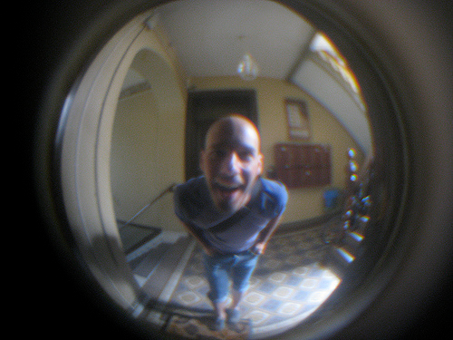


Secondary Goals
Camera
Use to capture identity of unwanted access
Two-factor Authentication
Increased security
Knowledge and possession factors
Guest access
Expand Android app to provide guest access feature
Multiple users in the same household
3D-Print case to cover Pi/System
Notes:
SECONDARY GOALS

Slide 10
Questions & Comments

